Slide 1
CU Fixit:
Cloud-based Web Service for Community Feedback and Infrastructure Maintenance
Jesse Woo, Catelen Wu, Ethan Wu
Cloud Computing and Big Data
Spring 2023

Slide 2
Problem and Motivation
Maintainers require intelligence about when/where infrastructure maintenance issues occur
Different reports go to different departments, no central place to analyze trends in service requests
Community members lack a central place to report problems
Lack of transparency about progress of service requests

Slide 3
Overview
Community members authenticate through Cognito, and then are able to submit a report and attach a picture
They can also view their existing reports and the status of the report which indicates its progress
Maintainers also authenticate through Cognito
Can view individual reports
Can search reports by status, location, or keyword
Can perform additional grouping based on combinations of attributes
Or manually based on the maintainer’s own judgement

Slide 4
Frontend: Overview
Frontend built using REACT and Material UI libraries
Supports pagination when get requests return large numbers of results
Maintainer functionality is significantly more complicated than community member’s view
More than twice as many APIs
Grouping and viewing reports more complicated for maintainer

Slide 5
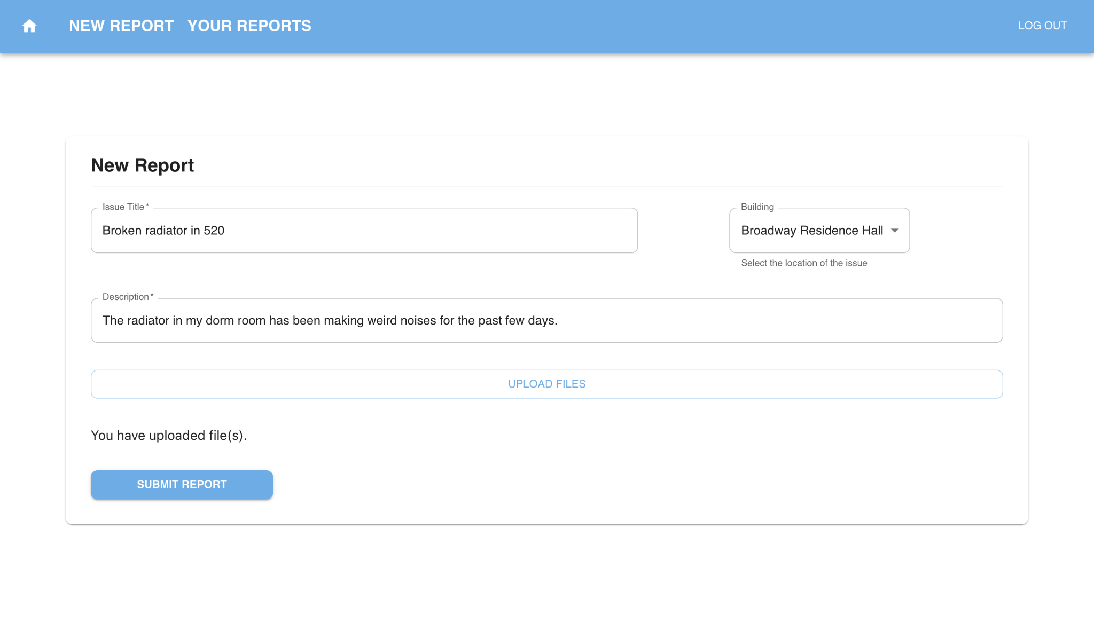
Frontend: Community Member

Slide 6
Frontend: Community Member

Slide 7
Frontend: Community Member
Must provide a title, description, and choose a location from a predefined drop-down menu
Community members can view their existing reports and the status of those reports as CREATED, REVIEWED, IN PROGRESS, or CLOSED
Can click through to details of reports

Slide 8
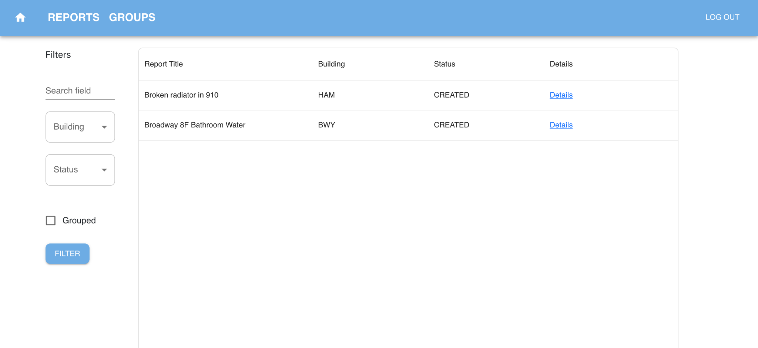
Frontend: Maintainer

Slide 9
Frontend: Maintainer

Slide 10
Frontend: Maintainer
Maintainers can see all reports and view their details, their groupings, and add a suggested report to a grouping
Can filter by building, grouping, status, or by keyword search
Grouping is one of the key features for the maintainer frontend
Want maintainers to see where similar reports are occurring over time, or when reports are likely duplicates

Slide 11
AWS Microservices
Cognito for authentication
API Gateway to manage APIs
S3 for photo storage and devops pipelines
DynamoDB for record storage
OpenSearch for record indexing
Comprehend for keyword extraction
Rekognition for photo label extraction
SQS Queues for asynchronicity
Lambda functions to make the whole thing work

Slide 12
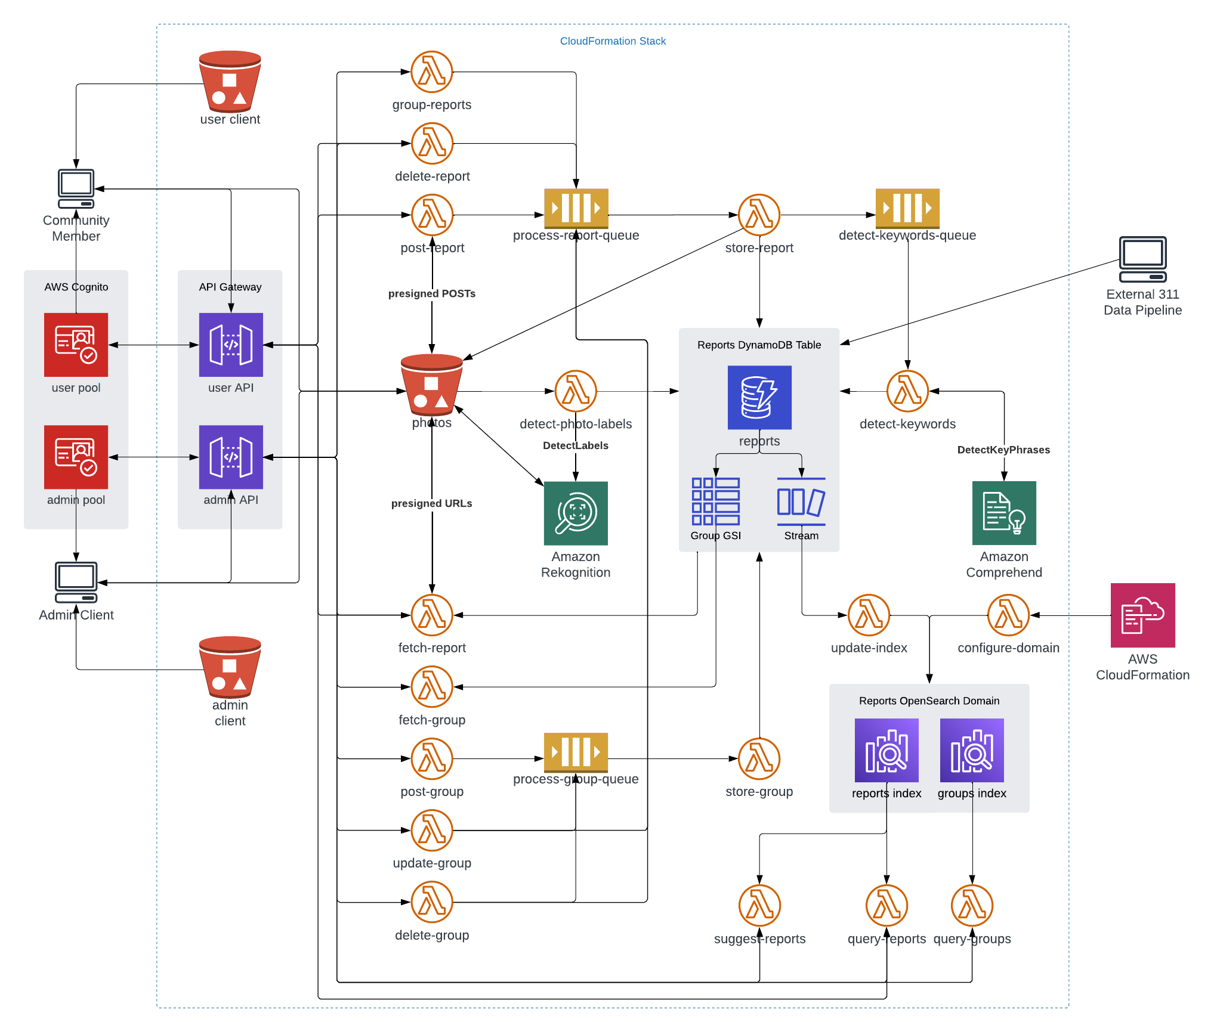
Architecture
Use of queues for and streams for asynchronicity and scale
Machine learning using AWS microservices
Cognito for authentication
Multiple indices to optimize searching reports and groupings

Slide 13
APIs: Community Members
/reports: GET: Fetch existing reports
/reports: POST: Submit a new report
/reports/{reportID}: GET: Fetch report by ID
/reports/{reportID}: GET: Delete report by ID

Slide 14
APIs: Maintainer
/groups: POST: Create a new report group
/groups: GET: Fetch existing groups
/groups/{groupId}: GET: Fetch group by ID
/groups/{groupId}: DELETE: Delete a report group by ID
/groups/{groupId}/suggest: GET: Suggest similar reports for the group
/groups/{groupId}/reports: POST: Add reports to a group
/reports: POST: Submit a new report
/reports: GET: Fetch existing reports
/reports/{reportId}: GET: Fetch report by ID
/reports/{reportId}: DELETE: Delete a report by ID

Slide 15
Lambda Functions: API Endpoints
fetch-reports: Handles GET requests for both community members and maintainers. A community member can search by their userID. A maintainer can search for individual reports by their ID or filter reports for bulk displays by searching based on the status, location, or userID. They can designation pagination with from and size parameters. Filtering relies on an OpenSearch index.
post-group: Creates a grouping of reports or adds a report to an existing grouping.
post-report: Processes a new report by assigning a reportID using UUID1(), and passes the report to an SQS queue to be further processed and stored in DynamoDB, which will later trigger the update-index lambda. Also generates a pre-signed URL that allows storage of images in an S3 bucket.
suggest-reports: Uses OpenSearch query multi-matching to suggest groupings of reports based on location and keywords extracted from text descriptions and photo labels. Suggested reports are returned to the maintainer front-end [and then what happens to them?]

Slide 16
Lambda Functions: Backend
detect-keywords: Pulls an event from an SQS queue and uses the Comprehend API to extract keywords from the report’s text description. Keywords are singularized and lowercase and stored in the DynamoDB.
detect-photo-labels: Triggered by a successful PUT or POST request to the cu-fixit-photos bucket. Uses the Rekognition API to extract up to 5 labels for the photo and then stores the labels in DynamoDB. Labels are singularized and lowercase.
update-index: Triggered by an event from DynamoDB whenever a new record is created. Indexes both individual reports and groupings of reports. Can also remove indices in response to a DELETE request.
store-group: Pulls from a queue to store groupings of reports from the post-group function.
store-report: Pulls from a queue to store individual reports from the post-report function. Also passes the text description to another queue for keyword extraction.
domain-setup: A helper function that generates indices in OpenSearch with the proper data mappings once CloudFormation provisions the domain.

Slide 17
Groupby Functionality
Suggested groupings based on a multi-match OpenSearch query
Match a combination of attributes from keywords, photo labels, location
Reports can also be added to groups after manual review
Groupings are separate from simply searching
Embed some level of intelligence about what kind of maintenance issues are arising and how they are related

Slide 18
Optimizations
All endpoints except fetches are asynchronous using SQS queues
Any change to the Dynamo table triggers a stream to the OpenSearch domain, which handles it asynchronously
The index supports datatype mapping to speed up searching
Building codes and ReportIDs are [I forget]
Keywords are string sets
Individual reports and groupings are stored together instead of in separate tables, with ID as a generic key and a global secondary index for groupID
This speeds up searching groups and works as a sparse index to identify reports that have not yet been grouped

Slide 19
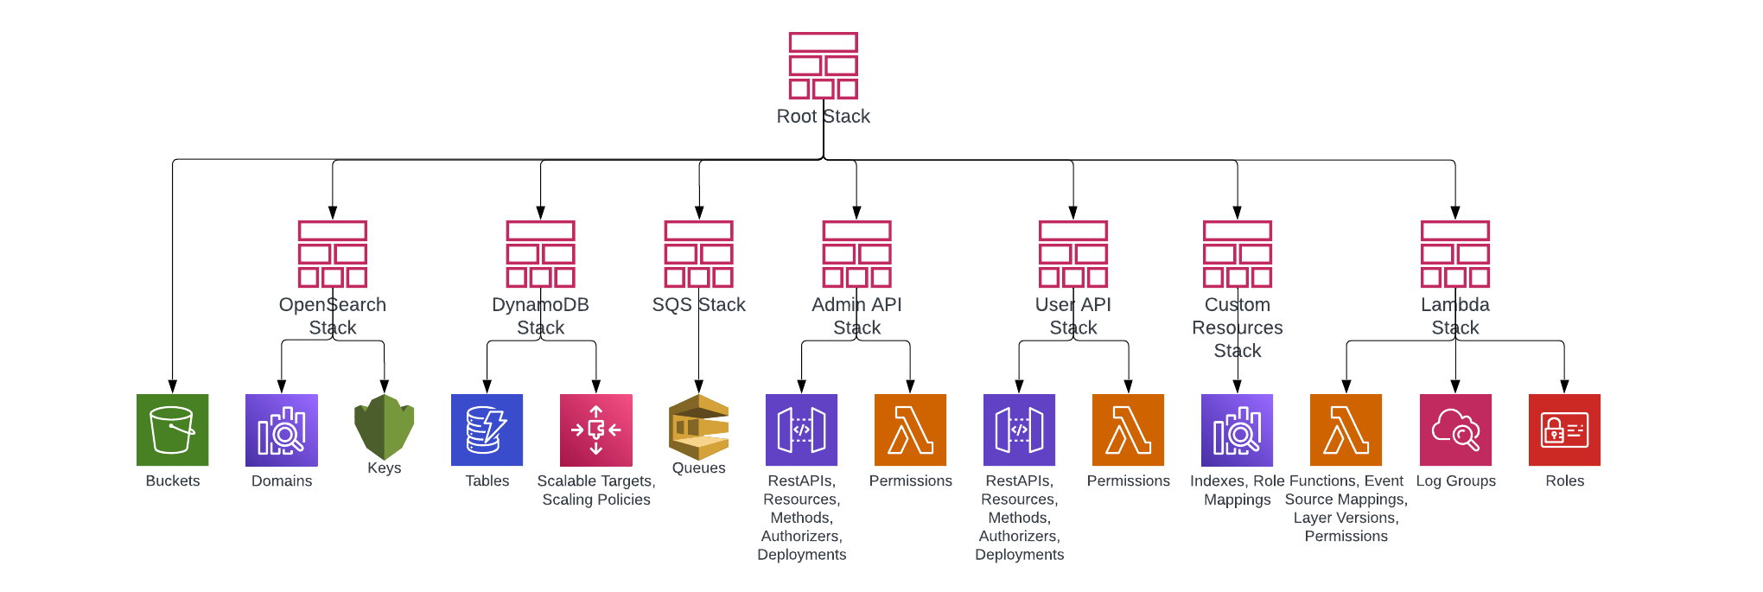
DevOps
CloudFormation allows us to spin the entire stack up or down easily
Configured with nested stack structure

Slide 20
External Data
NYC 311 Service Requests from 2010 to Present
33 million rows with request to many irrelevant departments: NYPD, Parks and Recreation, Taxi and Limo
Pulled requests from Jan. 2023, excluding non-useful complaint types like ‘unsanitary conditions’ and ‘heat/hot water’
Yielded around 100,000 records
Pruned requests that had been closed because the inspector could not reach the relevant physical location
Randomly sampled 2000 records from relevant complaint types
paint/plaster, plumbing, water leak, door/window, electric, flooring/stairs
Yielded 12000 records

Slide 21
Data cleaning and transformations
Had to build some fields synthetically to fit our schema and make sense as a Columbia University service request
userID: randomly generated in the form of a UNI
location: randomly assigned building from official code of CU buildings
title: concat complaint_type and location
description: complaint_type + descriptor + building type
keywords: a string-set of keywords from the description plus two randomly assigned keywords to allow more interesting groupings

Slide 22
Results: Methodology
Transformations and random sampling we performed on the 311 dataset were necessary, but reduced the usefulness of certain analytics such as associations based on location
However we preserved the integrity of the created_date and closed_date fields, so our analysis focuses on when service requests are created and closed.
Used PySpark in Colab notebook to save costs on AWS Glue deployment

Slide 23
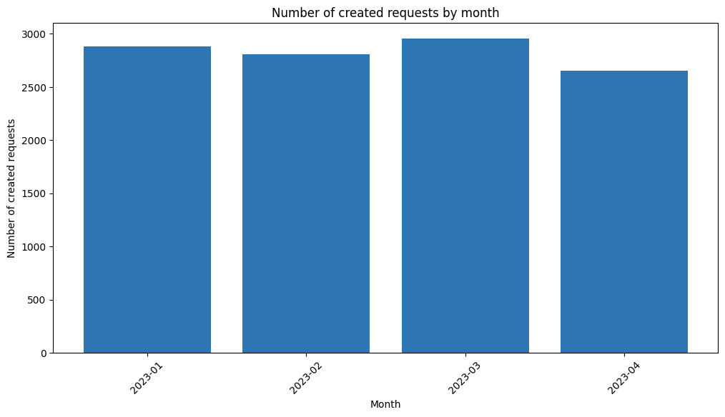
Results: When are new requests submitted?

Slide 24
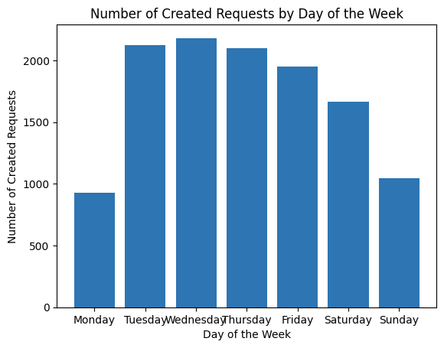
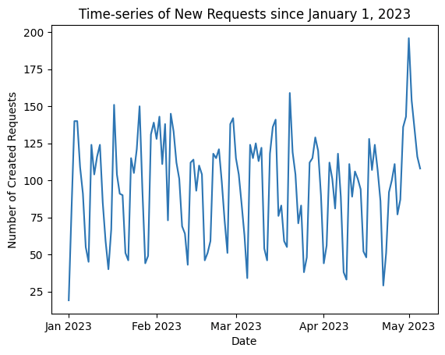
Results: When are new requests submitted?

Slide 25
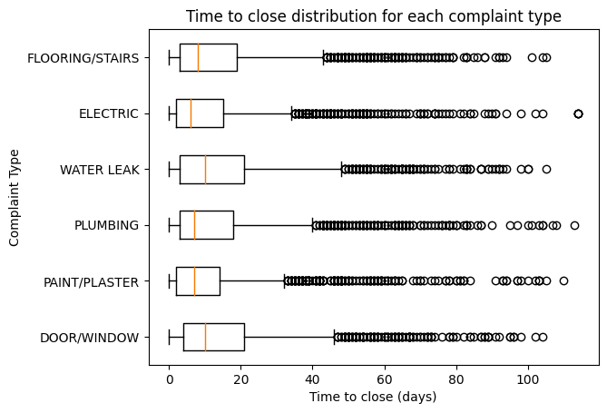
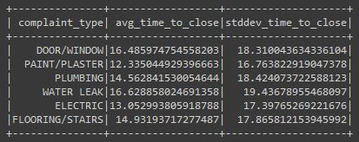
Results: Average time to close a request

Slide 26
Future Work
We originally planned to use K-nearest-neighbor (KNN) analysis to group reports together using machine learning, which is supported by OpenSearch
However we encountered problems vectorizing our inputs in a consistent way.
Relied on sklearn Bag of Words Vectorizer and PCA, but couldn’t make it work in Lambda
Possible to get better word embeddings with Doc2Vec, BERT-as-a-service, or OpenAI’s text embedding service
Wanted to incorporate streaming event Spark analytics but Glue is expensive
A mobile app would allow more granular location data and location based analytics such as heat mapping

Slide 27
Conclusion
Go team Woo/Wu!

